Slide 1
Creating Other Schema Objects
(Chapter 12 in our book)

Slide 2
Objectives
After completing this lesson, you should be able to do the following:
Create and retrieve data from simple and complex views
Create, maintain, and use sequences
Create and maintain indexes
Create private and public synonyms
Notes:
Objectives
In this lesson, you are introduced to the view, sequence, synonym, and index objects. You are taught the basics of creating and using views, sequences, and indexes.

Slide 3
Database Objects
Object
Description
Table
Basic unit of storage; composed of rows
View
Logically represents subsets of data from one or more tables
Sequence
Generates numeric values
Index
Improves the performance of data retrieval queries
Synonym
Gives alternative names to objects
Notes:
Database Objects
There are several other objects in a database in addition to tables. In this lesson, you learn about the views, sequences, indexes, and synonyms.
With views, you can present and hide data from the tables.
Many applications require the use of unique numbers as primary key values. You can either build code into the application to handle this requirement or use a sequence to generate unique numbers.
If you want to improve the performance of data retrieval queries, you should consider creating an index. You can also use indexes to enforce uniqueness on a column or a collection of columns.
You can provide alternative names for objects by using synonyms.

Slide 4
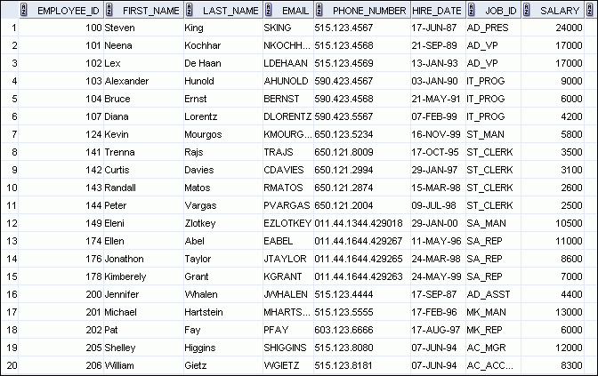
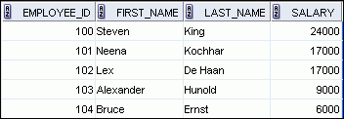
A View is a “virtual table” based on other tables. It is essentially a named query.
EMPLOYEES table
Notes:
What Is a View?
You can present logical subsets or combinations of data by creating views of tables. A view is a logical table based on a table or another view. A view contains no data of its own, but is like a window through which data from tables can be viewed or changed. The tables on which a view is based are called base tables. The view is stored as a SELECT statement in the data dictionary.

Slide 5

Advantages of Views
To make complex queries look simple
To restrict
access to data to authorized users
To present different views of the same data
Notes:
Advantages of Views
Views restrict access to the data because it displays selected columns from the table.
Views can be used to make simple queries to retrieve the results of complicated queries. For example, views can be used to query information from multiple tables without the user knowing how to write a join statement.
Views provide data independence for ad hoc users and application programs. One view can be used to retrieve data from several tables.
Views provide groups of users access to data according to their particular criteria.
For more information, see the section on “CREATE VIEW” in the Oracle Database SQL Language Reference 11g, Release 1 (11.1).

Slide 6
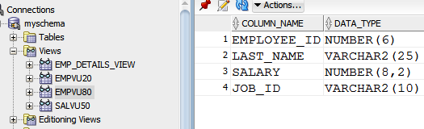
Creating a View
CREATE OR REPLACE VIEW empvu80
AS SELECT employee_id, last_name, salary, job_id
FROM employees
WHERE department_id = 80;
Glasses indicate a view
Notes:
Creating a View (continued)
The example in the slide creates a view that contains the employee number, last name, and salary for each employee in department 80.
You can display the structure of the view by using the DESCRIBE command.
Guidelines
The subquery that defines a view can contain complex SELECT syntax, including joins, groups, and subqueries.
If you do not specify a constraint name for the view created with the WITH CHECK OPTION, the system assigns a default name in the SYS_Cn format.
You can use the OR REPLACE option to change the definition of the view without dropping and re-creating it, or regranting the object privileges previously granted on it.

Slide 7
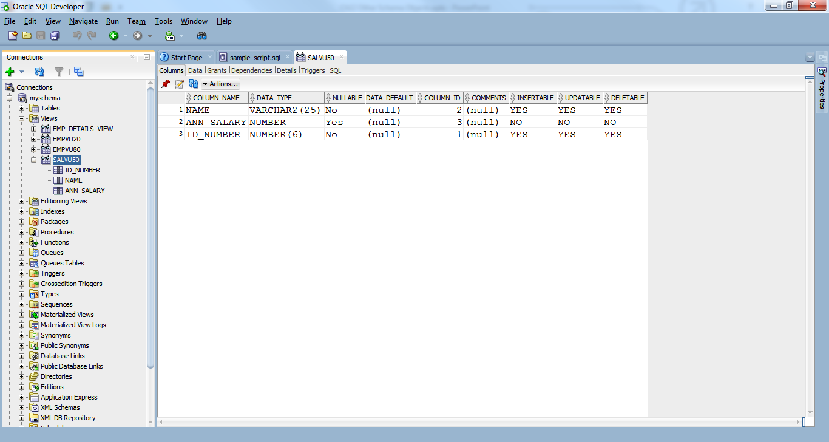
Creating a View with Column aliases
CREATE OR REPLACE VIEW salvu50
AS SELECT employee_id ID_NUMBER, last_name NAME,
salary*12 ANN_SALARY
FROM employees
WHERE department_id = 50;
Notes:
Creating a View (continued)
You can control the column names by including column aliases in the subquery.
The example in the slide creates a view containing the employee number (EMPLOYEE_ID) with the alias ID_NUMBER, name (LAST_NAME) with the alias NAME, and annual salary (SALARY) with the alias ANN_SALARY for every employee in department 50.
Alternatively, you can use an alias after the CREATE statement and before the SELECT subquery. The number of aliases listed must match the number of expressions selected in the subquery.
CREATE OR REPLACE VIEW salvu50 (ID_NUMBER, NAME, ANN_SALARY)
AS SELECT employee_id, last_name, salary*12
FROM employees
WHERE department_id = 50;

Slide 8
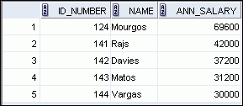
Retrieving Data from a View
SELECT *
FROM salvu50;
You can retrieve data from a view as you would from any table. You can display either the contents of the entire view or just specific rows and columns.
This is one way it makes complex queries easier for users to work with.
Notes:
Retrieving Data from a View

Slide 9
Modifying a View
Modify EMPVU80 view -- add an alias for each column name:
Column aliases in the CREATE OR REPLACE VIEW clause are listed in the same order as the columns in the subquery.
CREATE OR REPLACE VIEW empvu80
(id_number, fullname, sal, department_id)
AS SELECT employee_id, first_name || ' '
|| last_name, salary, department_id
FROM employees
WHERE department_id = 80;
Notes:
Modifying a View
With the OR REPLACE option, a view can be created even if one exists with this name already, thus replacing the old version of the view for its owner. This means that the view can be altered without dropping, re-creating, and regranting object privileges.
Note: When assigning column aliases in the CREATE OR REPLACE VIEW clause, remember that the aliases are listed in the same order as the columns in the subquery.

Slide 10
Simple vs Complex Views
Feature
Simple Views
Complex Views
Number of tables
One
One or more
Contain functions
No
Yes
Contain groups of data
No
Yes
DML (INSERT, UPDATE, DELETE) operations through a view
Yes
Not always
Notes:
Simple Views and Complex Views
There are two classifications for views: simple and complex. The basic difference is related to the DML (INSERT, UPDATE, and DELETE) operations.
A simple view is one that:
Derives data from only one table
Contains no functions or groups of data
Can perform DML operations through the view
A complex view is one that:
Derives data from many tables
Contains functions or groups of data
Does not always allow DML operations through the view

Slide 11
Creating a Complex View
Ex: a complex view that may contain group functions as well as data from the join of two tables:
CREATE OR REPLACE VIEW dept_sum_vu
(name, minsal, maxsal, avgsal)
AS SELECT d.department_name, MIN(e.salary),
MAX(e.salary),AVG(e.salary)
FROM employees e JOIN departments d
ON (e.department_id = d.department_id)
GROUP BY d.department_name;
Notes:
Creating a Complex View
The example in the slide creates a complex view of department names, minimum salaries, maximum salaries, and the average salaries by department. Note that alternative names have been specified for the view. This is a requirement if any column of the view is derived from a function or an expression.
You can view the structure of the view by using the DESCRIBE command. Display the contents of the view by issuing a SELECT statement.
SELECT *
FROM dept_sum_vu;

Slide 12
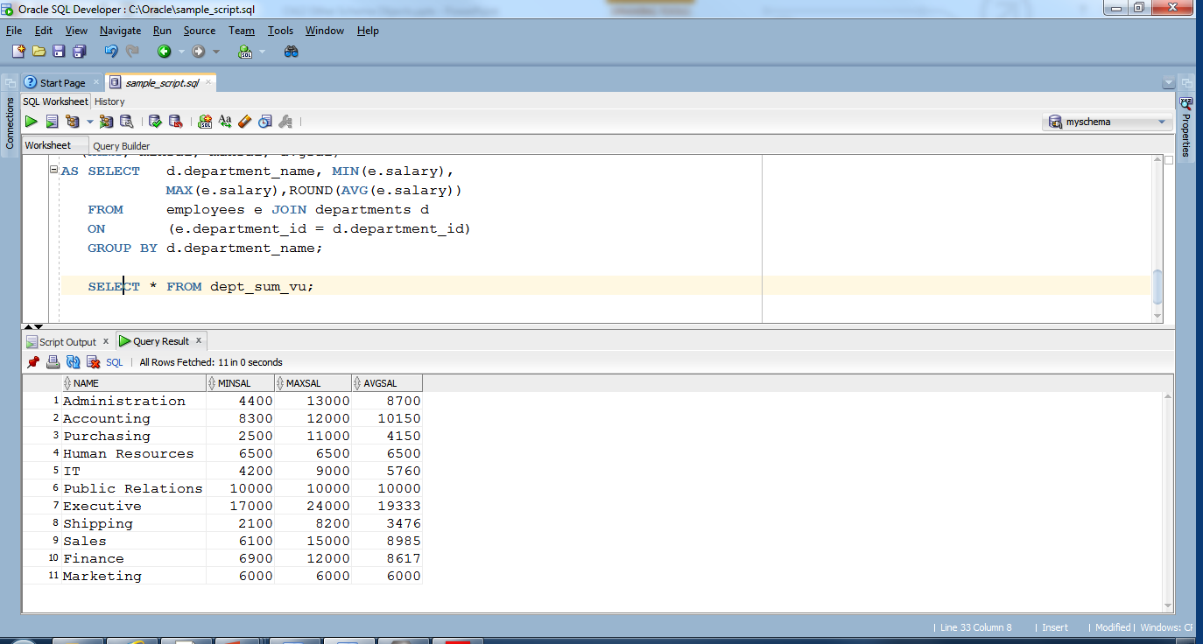
Querying the view

Slide 13


Rules for Performing DML Operations on a View
You can usually perform DML operations on simple views.
No DML if the view contains the following:
Group functions
A GROUP BY clause
The DISTINCT keyword
ROWNUM keyword
Notes:
Rules for Performing DML Operations on a View
You can perform DML operations on data through a view if those operations follow certain rules.
You can remove a row from a view unless it contains any of the following:
Group functions
A GROUP BY clause
The DISTINCT keyword
The pseudocolumn ROWNUM keyword

Slide 14
How could you update the average salary? For example, update 10000 to 12000: UPDATE dept_sum_vu SET avgsal = 20000 WHERE name LIKE ‘Public%’;.
10000 is an average—which comes from many salaries. How could Oracle update these salaries, so that the average came out to 12000? The answer is… it can’t. There are too many ways to do that.

Slide 15
Options when Creating a View
CREATE [OR REPLACE] [FORCE|NOFORCE] VIEW view
[(alias[, alias]...)]
AS subquery
[WITH CHECK OPTION [CONSTRAINT constraint]]
[WITH READ ONLY [CONSTRAINT constraint]];
WITH CHECK OPTION Specifies that only those rows that are accessible to the view can be inserted or updated
FORCE Creates the view regardless of whether or not the base tables exist
NOFORCE Creates the view only if the base tables exist (This is the default.)
WITH READ ONLY Specifies that the resulting data is read-only, i.e. no DML can be performed on it
Notes:
Creating a View
You can create a view by embedding a subquery in the CREATE VIEW statement.
In the syntax:
OR REPLACE Re-creates the view if it already exists
FORCE Creates the view regardless of whether or not the base tables exist
NOFORCE Creates the view only if the base tables exist (This is the default.)
view Is the name of the view
alias Specifies names for the expressions selected by the view’s query (The number of aliases must match the number of expressions selected by the view.)
subquery Is a complete SELECT statement (You can use aliases for the columns in the SELECT list.)
WITH CHECK OPTION Specifies that only those rows that are accessible to the view can be inserted or updated
constraint Is the name assigned to the CHECK OPTION constraint
WITH READ ONLY ensures that no DML operations can be performed on this view
Note: In SQL Developer, click the Run Script icon or press [F5] to run the data definition language (DDL) statements. The feedback messages will be shown on the Script Output tabbed page.

Slide 16
WITH CHECK CONSTRAINT This ensures that INSERTs and UPDATEs don’t take the row out of the view.
CREATE OR REPLACE VIEW empvu20
AS SELECT *
FROM employees
WHERE department_id = 20
WITH CHECK OPTION CONSTRAINT empvu20_ck ;
UPDATE empvu20
SET department_id = 10
WHERE employee_id = 201;
Error report -
SQL Error: ORA-01402: view WITH CHECK OPTION
where-clause violation
The UPDATE fails because, if the department id
were to change to 10, that would “kick out” emp 201 from the view. WITH CHECK OPTION does not allow this to happen.
Notes:
Denying DML Operations (continued)
Any attempt to remove a row from a view with a read-only constraint results in an error:
DELETE FROM empvu10
WHERE employee_number = 200;
Similarly, any attempt to insert a row or modify a row using the view with a read-only constraint results in the same error.
No rows are updated because, if the department number
were to change to 10, the view would no longer be able to see employee 201. It would “kick out” emp 201 from the view.

Slide 17

Denying DML Operations (INSERT, UPDATE, or DELETE)
You can ensure that no DML operations occur by adding the WITH READ ONLY option to your view definition.
Notes:
Denying DML Operations
You can ensure that no DML operations occur on your view by creating it with the WITH READ ONLY option. The example in the next slide modifies the EMPVU10 view to prevent any DML operations on the view.

Slide 18
Denying DML Operations
CREATE OR REPLACE VIEW empvu10
(employee_number, employee_name, job_title)
AS SELECT employee_id, last_name, job_id
FROM employees
WHERE department_id = 10
WITH READ ONLY ;
UPDATE empvu10
SET employee_name = ‘Michaels’
WHERE employee_number = 128;
Error at Command Line : 9 Column : 5
Error report -
SQL Error: ORA-42399: cannot perform a DML operation
on a read-only view
Notes:
Denying DML Operations (continued)
Any attempt to remove a row from a view with a read-only constraint results in an error:
DELETE FROM empvu10
WHERE employee_number = 200;
Similarly, any attempt to insert a row or modify a row using the view with a read-only constraint results in the same error.

Slide 19
Removing a View
You can remove a view without losing data because a view is based on underlying tables in the database, which are not affected by the DROP.
DROP VIEW view;
DROP VIEW empvu80;
Notes:
Removing a View
You use the DROP VIEW statement to remove a view. The statement removes the view definition from the database. However, dropping views has no effect on the tables on which the view was based. On the other hand, views or other applications based on the deleted views become invalid. Only the creator or a user with the DROP ANY VIEW privilege can remove a view.
In the syntax:
view is the name of the view

Slide 20
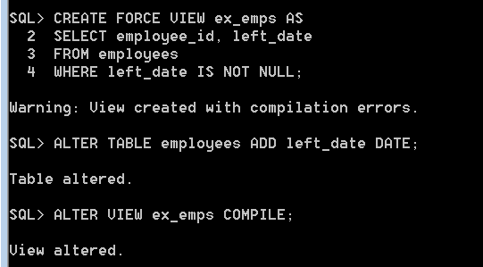
Compiling a view
A view must be successfully compiled before it can be used.
Oracle attempts to compile a view when it is created.
But a view can be created with the FORCE option, without the underlying table/columns existing
Notes:
Practice 11: Overview of Part 1
Part 1 of this lesson’s practice provides you with a variety of exercises in creating, using, and removing views. Complete questions 1–6 at the end of this lesson.
There is no left_date column

Slide 21
Sequences
Object
Description
Table
Basic unit of storage; composed of rows
View
Logically represents subsets of data from one or more tables
Sequence
Generates numeric values
Index
Improves the performance of some queries
Synonym
Gives alternative names to objects
Notes:
Sequences
A sequence is a database object that creates integer values. You can create sequences and then use them to generate numbers.

Slide 22

Sequences
A sequence:
Can automatically generate unique numbers
Is a shareable object
Can be used to create a primary key value
Replaces application code
Speeds up the efficiency of accessing sequence values when cached in memory
2
4
6
8
10
1
3
5
7
9
Notes:
Sequences (continued)
A sequence is a user-created database object that can be shared by multiple users to generate integers.
You can define a sequence to generate unique values or to recycle and use the same numbers again.
A typical usage for sequences is to create a primary key value, which must be unique for each row. A sequence is generated and incremented (or decremented) by an internal Oracle routine. This can be a time-saving object because it can reduce the amount of application code needed to write a sequence-generating routine.
Sequence numbers are stored and generated independent of tables. Therefore, the same sequence can be used for multiple tables.

Slide 23
CREATE SEQUENCE Statement: Syntax
Define a sequence to generate sequential numbers automatically:
CREATE SEQUENCE sequence
[INCREMENT BY n]
[START WITH n]
[{MAXVALUE n | NOMAXVALUE}]
[{MINVALUE n | NOMINVALUE}]
[{CYCLE | NOCYCLE}]
[{CACHE n | NOCACHE}];
Notes:
CREATE SEQUENCE Statement: Syntax
Automatically generate sequential numbers by using the CREATE SEQUENCE statement.
In the syntax:
sequence Is the name of the sequence generator
INCREMENT BY n Specifies the interval between sequence numbers, where n is an integer (If this clause is omitted, the sequence increments by 1.)
START WITH n Specifies the first sequence number to be generated (If this clause is omitted, the sequence starts with 1.)
MAXVALUE n Specifies the maximum value the sequence can generate
NOMAXVALUE Specifies a maximum value of 10^27 for an ascending sequence and –1 for a descending sequence (This is the default option.)
MINVALUE n Specifies the minimum sequence value
NOMINVALUE Specifies a minimum value of 1 for an ascending sequence and –(10^26) for a descending sequence (This is the default option.)

Slide 24
Creating a Sequence
Create a sequence named DEPT_DEPTID_SEQ to be used for the primary key of the DEPARTMENTS table.
Do not use the CYCLE option for primary key values.
CREATE SEQUENCE dept_deptid_seq
INCREMENT BY 10
START WITH 120
MAXVALUE 9999
NOCACHE
NOCYCLE;
Notes:
Creating a Sequence (continued)
CYCLE | NOCYCLE Specifies whether the sequence continues to generate values after reaching its maximum or minimum value (NOCYCLE is the default option.)
CACHE n | NOCACHE Specifies how many values the Oracle server preallocates and keeps in memory (By default, the Oracle server caches 20 values.)
The example in the slide creates a sequence named DEPT_DEPTID_SEQ to be used for the DEPARTMENT_ID column of the DEPARTMENTS table. The sequence starts at 120, does not allow caching, and does not cycle.
Do not use the CYCLE option if the sequence is used to generate primary key values, unless you have a reliable mechanism that purges old rows faster than the sequence cycles.
For more information, see the section on “CREATE SEQUENCE” in the Oracle Database SQL Language Reference 11g, Release 1 (11.1).
Note: The sequence is not tied to a table. Generally, you should name the sequence after its intended use. However, the sequence can be used anywhere, regardless of its name.
Note: The sequence is not tied to a table. Generally, you should name the sequence after its intended use. However, the sequence can be used anywhere, regardless of its name.

Slide 25
NEXTVAL and CURRVAL Pseudocolumns
NEXTVAL returns the next available sequence value. It returns a unique value every time it is referenced, even for different users.
CURRVAL obtains the current sequence value.
NEXTVAL must be issued for that sequence before CURRVAL contains a value.
Notes:
NEXTVAL and CURRVAL Pseudocolumns
After you create your sequence, it generates sequential numbers for use in your tables. Reference the sequence values by using the NEXTVAL and CURRVAL pseudocolumns.
The NEXTVAL pseudocolumn is used to extract successive sequence numbers from a specified sequence. You must qualify NEXTVAL with the sequence name. When you reference sequence.NEXTVAL, a new sequence number is generated and the current sequence number is placed in CURRVAL.
The CURRVAL pseudocolumn is used to refer to a sequence number that the current user has just generated. However, NEXTVAL must be used to generate a sequence number in the current user’s session before CURRVAL can be referenced. You must qualify CURRVAL with the sequence name. When you reference sequence.CURRVAL, the last value returned to that user’s process is displayed.

Slide 26
Go to “Notes Page” View
Notes:
NEXTVAL and CURRVAL Pseudocolumns (continued)
Rules for Using NEXTVAL and CURRVAL
You can use NEXTVAL and CURRVAL in the following contexts:
The SELECT list of a SELECT statement that is not part of a subquery
The SELECT list of a subquery in an INSERT statement
The VALUES clause of an INSERT statement
The SET clause of an UPDATE statement
You cannot use NEXTVAL and CURRVAL in the following contexts:
The SELECT list of a view
A SELECT statement with the DISTINCT keyword
A SELECT statement with GROUP BY, HAVING, or ORDER BY clauses
A subquery in a SELECT, DELETE, or UPDATE statement
The DEFAULT expression in a CREATE TABLE or ALTER TABLE statement
For more information, see the sections on “Pseudocolumns” and “CREATE SEQUENCE” in Oracle Database SQL Language Reference 11g, Release 1 (11.1).

Slide 27
Using a Sequence
Insert a new department named “Support” in location ID 2500:
View the current value for the DEPT_DEPTID_SEQ sequence:
INSERT INTO departments(department_id,
department_name, location_id)
VALUES (dept_deptid_seq.NEXTVAL,
'Support', 2500);
SELECT dept_deptid_seq.CURRVAL
FROM dual;
Notes:
Using a Sequence
The example in the slide inserts a new department in the DEPARTMENTS table. It uses the DEPT_DEPTID_SEQ sequence to generate a new department number as follows.
You can view the current value of the sequence using the sequence_name.CURRVAL, as shown in the second slide example. The output of the query is shown below:
Suppose that you now want to hire employees to staff the new department. The INSERT statement to be executed for all new employees can include the following code:
INSERT INTO employees (employee_id, department_id, ...)
VALUES (employees_seq.NEXTVAL, dept_deptid_seq .CURRVAL, ...);
Note: The preceding example assumes that a sequence called EMPLOYEE_SEQ has already been created to generate new employee numbers.

Slide 28
Caching Sequence Values
Caching sequence values in memory gives faster access to those values.
Gaps in sequence values can occur when:
A rollback occurs
The system crashes (cached values are lost)
A sequence is used in another table
One table gets one number and another table gets the next number
Notes:
Caching Sequence Values
You can cache sequences in memory to provide faster access to those sequence values. The cache is populated the first time you refer to the sequence. Each request for the next sequence value is retrieved from the cached sequence. After the last sequence value is used, the next request for the sequence pulls another cache of sequences into memory.
Gaps in the Sequence
Although sequence generators issue sequential numbers without gaps, this action occurs independent of a commit or rollback. Therefore, if you roll back a statement containing a sequence, the number is lost.
Another event that can cause gaps in the sequence is a system crash. If the sequence caches values in memory, those values are lost if the system crashes.
Because sequences are not tied directly to tables, the same sequence can be used for multiple tables. However, if you do so, each table can contain gaps in the sequential numbers.

Slide 29
Modifying a Sequence
Change the increment value, maximum value, minimum value, cycle option, or cache option:
ALTER SEQUENCE dept_deptid_seq
INCREMENT BY 20
MAXVALUE 999999
NOCACHE
NOCYCLE;
Notes:
Modifying a Sequence
If you reach the MAXVALUE limit for your sequence, no additional values from the sequence are allocated and you will receive an error indicating that the sequence exceeds the MAXVALUE. To continue to use the sequence, you can modify it by using the ALTER SEQUENCE statement.
Syntax
ALTER SEQUENCE sequence
[INCREMENT BY n]
[{MAXVALUE n | NOMAXVALUE}]
[{MINVALUE n | NOMINVALUE}]
[{CYCLE | NOCYCLE}]
[{CACHE n | NOCACHE}];
In the syntax, sequence is the name of the sequence generator.
For more information, see the section on “ALTER SEQUENCE” in Oracle Database SQL Language Reference 11g, Release 1 (11.1).

Slide 30
Guidelines for Modifying a Sequence
Use the ALTER statement for the sequence.
Only future sequence numbers are affected.
The sequence must be dropped and re-created to restart the sequence at a different number.
To remove a sequence, use the DROP statement:
DROP SEQUENCE dept_deptid_seq;
Notes:
Guidelines for Modifying a Sequence
You must be the owner or have the ALTER privilege for the sequence to modify it. You must be the owner or have the DROP ANY SEQUENCE privilege to remove it.
Only future sequence numbers are affected by the ALTER SEQUENCE statement.
The START WITH option cannot be changed using ALTER SEQUENCE. The sequence must be dropped and re-created to restart the sequence at a different number.
Some validation is performed. For example, a new MAXVALUE that is less than the current sequence number cannot be imposed.
ALTER SEQUENCE dept_deptid_seq
INCREMENT BY 20
MAXVALUE 90
NOCACHE
NOCYCLE;
The error:

Slide 31
Indexes
Object
Description
Table
Basic unit of storage; composed of rows
View
Logically represents subsets of data from one or more tables
Sequence
Generates numeric values
Index
Improves the performance of some queries
Synonym
Gives alternative names to objects
Notes:
Indexes
Indexes are database objects that you can create to improve the performance of some queries. Indexes can also be created automatically by the server when you create a primary key or a unique constraint.

Slide 32

Indexes
An index:
Used by the Oracle server to speed up the retrieval of rows
Can reduce disk I/O by using a rapid path access method to locate data quickly
Is independent of the table that it indexes (they can be added and dropped at any time.)
Is used and maintained automatically by the Oracle server
Notes:
Indexes (continued)
An Oracle server index is a schema object that can speed up the retrieval of rows by using a pointer. Indexes can be created explicitly or automatically. If you do not have an index on the column, then a full table scan occurs.
An index provides direct and fast access to rows in a table. Its purpose is to reduce the disk I/O by using an indexed path to locate data quickly. An index is used and maintained automatically by the Oracle server. After an index is created, no direct activity is required by the user.
Indexes are logically and physically independent of the table that they index. This means that they can be created or dropped at any time, and have no effect on the base tables or other indexes.
Note: When you drop a table, the corresponding indexes are also dropped.
For more information, see the section on “Schema Objects: Indexes” in Oracle Database Concepts 11g, Release 1 (11.1).

Slide 33


How Are Indexes Created?
Automatically: A unique index is created automatically when you define a PRIMARY KEY or UNIQUE constraint for a column in a table definition.
Manually: Users can create indexes on columns to speed up access to the rows.
Notes:
How Are Indexes Created?
You can create two types of indexes.
Unique index: The Oracle server automatically creates this index when you define a column in a table to have a PRIMARY KEY or a UNIQUE constraint. The name of the index is the name that is given to the constraint.
Nonunique index: This is an index that a user can create. For example, you can create the FOREIGN KEY column index for a join in a query to improve the speed of retrieval.
Note: You can manually create a unique index, but it is recommended that you create a unique constraint, which implicitly creates a unique index.

Slide 34
Creating an Index
Create an index on one or more columns:
Improve the speed of query access to the LAST_NAME column in the EMPLOYEES table:
CREATE [UNIQUE][BITMAP]INDEX index
ON table (column[, column]...);
CREATE INDEX emp_last_name_idx
ON employees(last_name);
Notes:
Creating an Index
Create an index on one or more columns by issuing the CREATE INDEX statement.
In the syntax:
index Is the name of the index
table Is the name of the table
column Is the name of the column in the table to be indexed
Specify UNIQUE to indicate that the value of the column (or columns) upon which the index is based must be unique. Specify BITMAP to indicate that the index is to be created with a bitmap for each distinct key, rather than indexing each row separately. Bitmap indexes store the rowids associated with a key value as a bitmap.
For more information, see the section on “CREATE INDEX” in Oracle Database SQL Language Reference 11g, Release 1 (11.1).

Slide 35


Index Creation Guidelines
Create an index when:
A column contains a wide range of values
A column contains a large number of null values
One or more columns are frequently used together in a WHERE clause or a join condition
The table is large and most queries are expected to retrieve less than 2% to 4% of the rows in the table
Do not create an index when:
The columns are not often used as a condition in the query
The table is small or most queries are expected to retrieve more than 2% to 4% of the rows in the table
The table is updated frequently
The indexed columns are referenced as part of an expression
Notes:
Index Creation Guidelines
More Is Not Always Better
Having more indexes on a table does not produce faster queries. Each DML operation that is committed on a table with indexes means that the indexes must be updated. The more indexes that you have associated with a table, the more effort the Oracle server must make to update all the indexes after a DML operation.
When to Create an Index
Therefore, you should create indexes only if:
The column contains a wide range of values
The column contains a large number of null values
One or more columns are frequently used together in a WHERE clause or join condition
The table is large and most queries are expected to retrieve less than 2% to 4% of the rows
Remember that if you want to enforce uniqueness, you should define a unique constraint in the table definition. A unique index is then created automatically.

Slide 36
Removing an Index
Remove an index from the data dictionary by using the DROP INDEX command:
Remove the emp_last_name_idx index from the data dictionary:
DROP INDEX index;
DROP INDEX emp_last_name_idx;
Notes:
Removing an Index
You cannot modify indexes. To change an index, you must drop it and then re-create it.
Remove an index definition from the data dictionary by issuing the DROP INDEX statement. To drop an index, you must be the owner of the index or have the DROP ANY INDEX privilege.
In the syntax, index is the name of the index.
Note: If you drop a table, indexes and constraints are automatically dropped but views and sequences remain.

Slide 37
Synonyms
Object
Description
Table
Basic unit of storage; composed of rows
View
Logically represents subsets of data from one or more tables
Sequence
Generates numeric values
Index
Improves the performance of some queries
Synonym
Gives alternative names to objects
Notes:
Synonyms
Synonyms are database objects that enable you to call a table by another name. You can create synonyms to give an alternative name to a table.

Slide 38
Creating a Synonym for an Object
A synonym is another name for an object. With synonyms, you can:
Create an easier reference to a table that is owned by another user
Shorten lengthy object names
Tables with synonyms can be renamed or relocated without having to change any code
CREATE [PUBLIC] SYNONYM synonym
FOR object;
Notes:
Creating a Synonym for an Object
To refer to a table that is owned by another user, you need to prefix the table name with the name of the user who created it, followed by a period. Creating a synonym eliminates the need to qualify the object name with the schema and provides you with an alternative name for a table, view, sequence, procedure, or other objects. This method can be especially useful with lengthy object names, such as views.
In the syntax:
PUBLIC Creates a synonym that is accessible to all users
synonym Is the name of the synonym to be created
object Identifies the object for which the synonym is created
Guidelines
The object cannot be contained in a package.
A private synonym name must be distinct from all other objects that are owned by the same user.
For more information, see the section on “CREATE SYNONYM” in Oracle Database SQL Language Reference 11g, Release 1 (11.1).

Slide 39
Creating and Removing Synonyms
Create a shortened name for the DEPT_SUM_VU view:
Drop a synonym:
CREATE SYNONYM d_sum
FOR dept_sum_vu;
DROP SYNONYM d_sum;
Notes:
Creating and Removing Synonyms
Creating a Synonym
The slide example creates a synonym for the DEPT_SUM_VU view for quicker reference.
The database administrator can create a public synonym that is accessible to all users. The following example creates a public synonym named DEPT for Alice’s DEPARTMENTS table:
CREATE PUBLIC SYNONYM dept
FOR alice.departments;
Removing a Synonym
To remove a synonym, use the DROP SYNONYM statement. Only the database administrator can drop a public synonym.
DROP PUBLIC SYNONYM dept;
For more information, see the section on “DROP SYNONYM” in Oracle Database SQL Language Reference 11g, Release 1 (11.1).

Slide 40
Public vs Private Synonyms
Public:
Only a DBA can create and drop
Can be referenced by any user in the database who has been granted privilege (not every user!)
Example: CREATE PUBLIC SYNONYM emp for human_resources.employees;
Private:
Created by user for their own schema
Refer to objects in user’s own schema
Example: CREATE SYNONYM emp for employees;
SELECT * FROM emp;
Which table does emp refer to? The local employees table in the user’s
Schema, or the employees table in the human_resources schema?

Slide 41
Summary
In this lesson, you should have learned how to:
Create, use, and remove views
Automatically generate sequence numbers by using a sequence generator
Create indexes to improve speed of query retrieval
Use synonyms to provide alternative names for objects
Notes:
Summary
In this lesson, you should have learned about database objects such as views, sequences, indexes, and synonyms.

Slide 42
Practice 12
This practice covers the following topics:
Creating sequences
Using sequences
Creating nonunique indexes
Creating synonyms
Notes:
Practice 12
Part 2 of this lesson’s practice provides you with a variety of exercises in creating and using a sequence, an index, and a synonym.

Slide 43
Notes:
Practice 12
Part 1
1. The staff in the HR department wants to hide some of the data in the EMPLOYEES table. They want a view called EMPLOYEES_VU based on the employee numbers, employee names, and department numbers from the EMPLOYEES table. They want the heading for the employee name to be EMPLOYEE.
2. Confirm that the view works. Display the contents of the EMPLOYEES_VU view.
3. Using your EMPLOYEES_VU view, write a query for the HR department to display all employee names and department numbers.
…
…

Slide 44
Notes:
Practice 12 (continued)
4. Department 50 needs access to its employee data. Create a view named DEPT50 that contains the employee numbers, employee last names, and department numbers for all employees in department 50. You have been asked to label the view columns EMPNO, EMPLOYEE, and DEPTNO. For security purposes, do not allow an employee to be reassigned to another department through the view.
5. Display the structure and contents of the DEPT50 view.
Test your view. Attempt to reassign Matos to department 80.

Slide 45
Notes:
Practice 12 (continued)
You need a sequence that can be used with the PRIMARY KEY column of the DEPT11 table*. The sequence should start at 300 and have a maximum value of 1,000. Have your sequence increment by 10. Name the sequence DEPT11_SEQ.
To test your sequence, write a script to insert two rows in the DEPT11 table. Be sure to use the sequence that you created above. Add two departments: Education and Administration. Confirm your additions. Run the commands in your script.
Create a nonunique index on the D_NAME column in the DEPT11 table.
Create a synonym for your EMPLOYEES table. Call it EMP12.
*If you don’t have DEPT11 table, run the following DML statements:
CREATE TABLE dept11
(d_num NUMBER(7),
d_name VARCHAR2(25),
CONSTRAINT dept11_d_num_pk PRIMARY KEY (d_num));
INSERT INTO dept11
SELECT department_id, department_name
FROM departments;

